Slide 1

2
Probability
Copyright © Cengage Learning. All rights reserved.

Slide 2
2.4
Conditional Probability
Copyright © Cengage Learning. All rights reserved.

Slide 3
Conditional Probability
The probabilities assigned to various events depend on what is known about the experimental situation when the assignment is made.
Subsequent to the initial assignment, partial information relevant to the outcome of the experiment may become available. Such information may cause us to revise some of our probability assignments.
For a particular event A, we have used P(A) to represent the probability, assigned to A; we now think of P(A) as the original, or unconditional probability, of the event A.

Slide 4
Conditional Probability
In this section, we examine how the information “an event B has occurred” affects the probability assigned to A.
For example, A might refer to an individual having a particular disease in the presence of certain symptoms.
If a blood test is performed on the individual and the result is negative (B = negative blood test), then the probability of having the disease will change (it should decrease, but not usually to zero, since blood tests are not infallible).

Slide 5
Conditional Probability
We will use the notation P(A | B) to represent the conditional probability of A given that the event B has occurred. B is the “conditioning event.” As an example, consider the event A that a randomly selected student at your university obtained all desired classes during the previous term’s registration cycle. Presumably P(A) is not very large.
However, suppose the selected student is an athlete who gets special registration priority (the event B). Then P(A | B) should be substantially larger than P(A), although perhaps still not close to 1.

Slide 6
Example 2.24
Complex components are assembled in a plant that uses two different assembly lines, A and A′.
Line A uses older equipment than A′, so it is somewhat slower and less reliable.
Suppose on a given day line A has assembled 8 components, of which 2 have been identified as defective (B) and 6 as nondefective (B′), whereas A′ has produced 1 defective and 9 nondefective components.

Slide 7
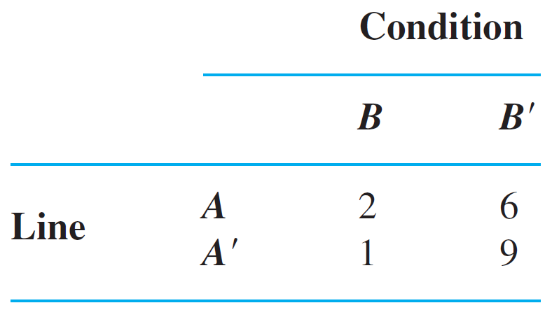
Example 2.24
cont’d
This information is summarized in the accompanying table.
Unaware of this information, the sales manager randomly selects 1 of these 18 components for a demonstration. Prior to the demonstration P(line A component selected) = P(A) = .44

Slide 8
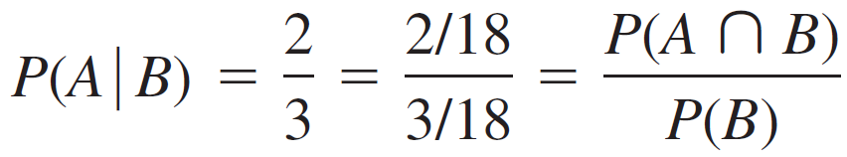
Example 2.24
cont’d
However, if the chosen component turns out to be defective, then the event B has occurred, so the component must have been 1 of the 3 in the B column of the table.
Since these 3 components are equally likely among themselves after B has occurred,
(2.2)

Slide 9
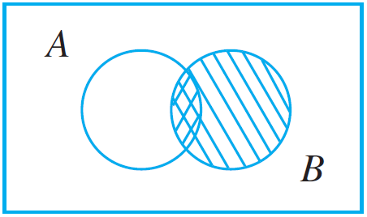
Conditional Probability
In Equation (2.2), the conditional probability is expressed as a ratio of unconditional probabilities: The numerator is the probability of the intersection of the two events, whereas the denominator is the probability of the conditioning event B. A Venn diagram illuminates this relationship (Figure 2.8).
Motivating the definition of conditional probability
Figure 2.8

Slide 10
Conditional Probability
Given that B has occurred, the relevant sample space is no longer S but consists of outcomes in B; A has occurred if and only if one of the outcomes in the intersection occurred, so the conditional probability of A given B is
proportional to The proportionality constant 1/P(B) is used to ensure that the probability P(B | B) of the new sample space B equals 1.

Slide 11
The Definition of Conditional Probability

Slide 12
The Definition of Conditional Probability
Example 2.24 demonstrates that when outcomes are equally likely, computation of conditional probabilities can be based on intuition. When experiments are more complicated, though, intuition may fail us, so a general definition of conditional probability is needed that will yield intuitive answers in simple problems. The Venn diagram and Equation (2.2) suggest how to proceed.

Slide 13
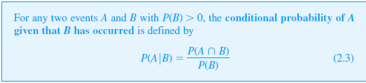
The Definition of Conditional Probability
Definition

Slide 14
Example 2.25
Suppose that of all individuals buying a certain digital camera, 60% include an optional memory card in their purchase, 40% include an extra battery, and 30% include both a card and battery. Consider randomly selecting a buyer and let
A = {memory card purchased} and B = {battery purchased}.
Then P(A) = .60, P(B) = .40, P(both purchased) = P(A ∩ B) = .30

Slide 15

Example 2.25
cont’d
Given that the selected individual purchased an extra battery, the probability that an optional card was also purchased is
That is, of all those purchasing an extra battery, 75% purchased an optional memory card. Similarly, P (battery | memory card) =
Notice that ≠ P(A) and ≠ P(B).

Slide 16
The Multiplication Rule for P(A ∩ B)

Slide 17

The Multiplication Rule for P(A ∩ B)
The definition of conditional probability yields the following result, obtained by multiplying both sides of Equation (2.3) by P(B). The Multiplication Rule This rule is important because it is often the case that P(A ∩ B) is desired, whereas both P(B) and can be specified from the problem description. Consideration of gives P(A ∩ B) =  P(A)

Slide 18

Example 2.27
Four individuals have responded to a request by a blood bank for blood donations. None of them has donated before, so their blood types are unknown. Suppose only type O+ is desired and only one of the four actually has this type. If the potential donors are selected in random order for typing, what is the probability that at least three individuals must be typed to obtain the desired type?
Making the identification B = {first type not O+} and
A = {second type not O+}, P(B) =

Slide 19
Example 2.27
cont’d
Given that the first type is not O+, two of the three
individuals left are not O+, so
The multiplication rule now gives
P (at least three individuals are typed) = P(A ∩ B)

Slide 20

Example 2.27
cont’d
The multiplication rule is most useful when the experiment consists of several stages in succession.
The conditioning event B then describes the outcome of the first stage and A the outcome of the second, so that —conditioning on what occurs first—will often be known.
The rule is easily extended to experiments involving more than two stages.

Slide 21
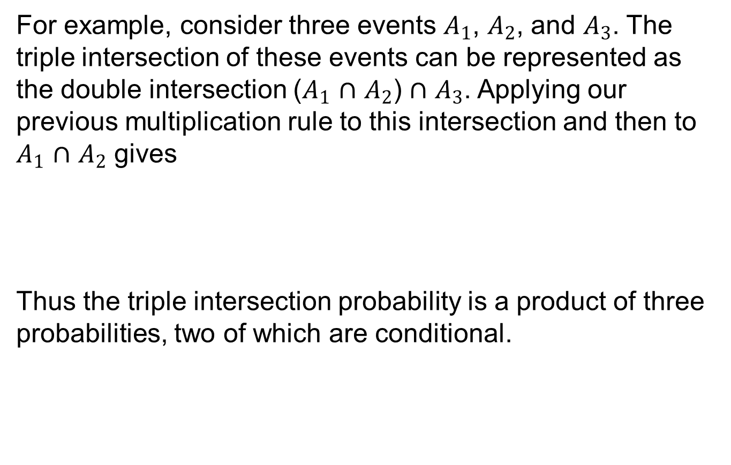
Example 2.27
cont’d
For example, consider three events $A_{1}$, $A_{2}$, and $A_{3}$. The triple intersection of these events can be represented as the double intersection ($A_{1}$ $∩$ $A_{2}$) $∩$ $A_{3}$. Applying our previous multiplication rule to this intersection and then to $A_{1}$ $∩$ $A_{2}$ gives
Thus the triple intersection probability is a product of three probabilities, two of which are conditional.

Slide 22
Bayes’ Theorem

Slide 23

Bayes’ Theorem
The computation of a posterior probability from given prior probabilities P(A_{i}) and conditional probabilities occupies a central position in elementary probability. The general rule for such computations, which is really just a simple application of the multiplication rule, goes back to Reverend Thomas Bayes, who lived in the eighteenth century. To state it we first need another result. Recall that events A₁, . . . , A_{k} are mutually exclusive if no two have any common outcomes. The events are exhaustive if one A_{i} must occur, so that A₁ ∪ …∪ A_{k} =

Slide 24
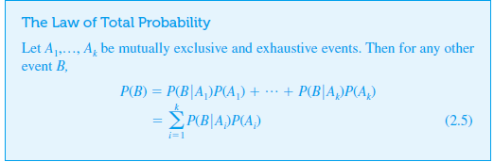
Bayes’ Theorem

Slide 25
Example 2.30
An individual has 3 different email accounts. Most of her messages, in fact 70%, come into account #1, whereas 20% come into account #2 and the remaining 10% into account #3.
Of the messages into account #1, only 1% are spam, whereas the corresponding percentages for accounts #2 and #3 are 2% and 5%, respectively.
What is the probability that a randomly selected message is spam?

Slide 26
Example 2.30
cont’d
To answer this question, let’s first establish some notation:
A_{i} = {message is from account # i} for i = 1, 2, 3,
B = {message is spam}
Then the given percentages imply that P(A₁) = .70, P(A₂) = .20, P(A₃) = .10

Slide 27
Example 2.30
cont’d
Now it is simply a matter of substituting into the equation for the law of total probability: P(B) = (.01)(.70) + (.02)(.20) + (.05)(.10) = .016 In the long run, 1.6% of this individual’s messages will be spam.

Slide 28
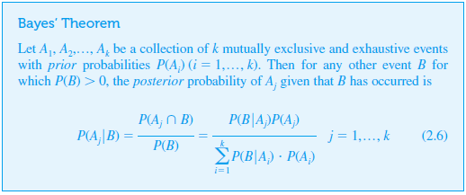
Bayes’ Theorem

Slide 29
Bayes’ Theorem
The transition from the second to the third expression in (2.6) rests on using the multiplication rule in the numerator and the law of total probability in the denominator. The proliferation of events and subscripts in (2.6) can be a bit intimidating to probability newcomers. As long as there are relatively few events in the partition, a tree diagram (as in Example 2.29) can be used as a basis for calculating posterior probabilities without ever referring explicitly to Bayes’ theorem.

